Slide 1
How to build an Industry Cost Profile (ICP) for a product in China
Identify industry code based on the supplier’s business and product
Step 2
Identify data sources for financial and manufacturing information related to industry code
Step 3
Step 1
Use industry data to calculate ratios for DM, DL, MOH, COGS, GSA & PBT

Slide 2
Step 1
Identify industry code based on the supplier’s business and product
Identify industry based on the supplier’s business and product
In our example:
Business: Metal Manufacturing
Product: Fabricated Metal Products

Slide 3
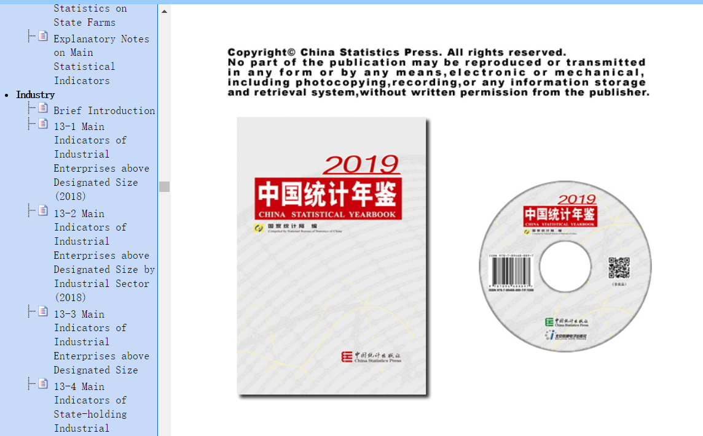
Identify Industry & obtain Financial and Manufacturing Information Related to Industry.
Step 2
Go to
Scroll down on the left menu & click on “Industries”. Next click on “13-2 Main Indicators of Industrial Enterprises above Designated Size by Industrial Sector (2018)” for data on manufacturing
http://www.stats.gov.cn/tjsj/ndsj/2019/indexeh.htm

Slide 4
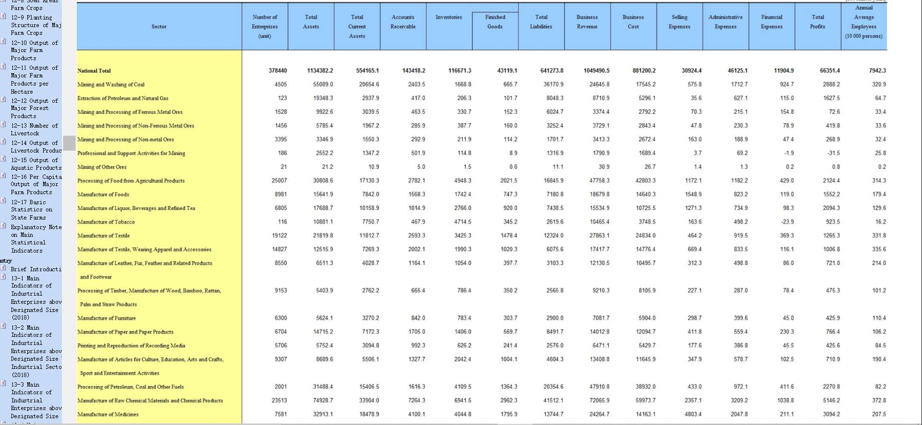
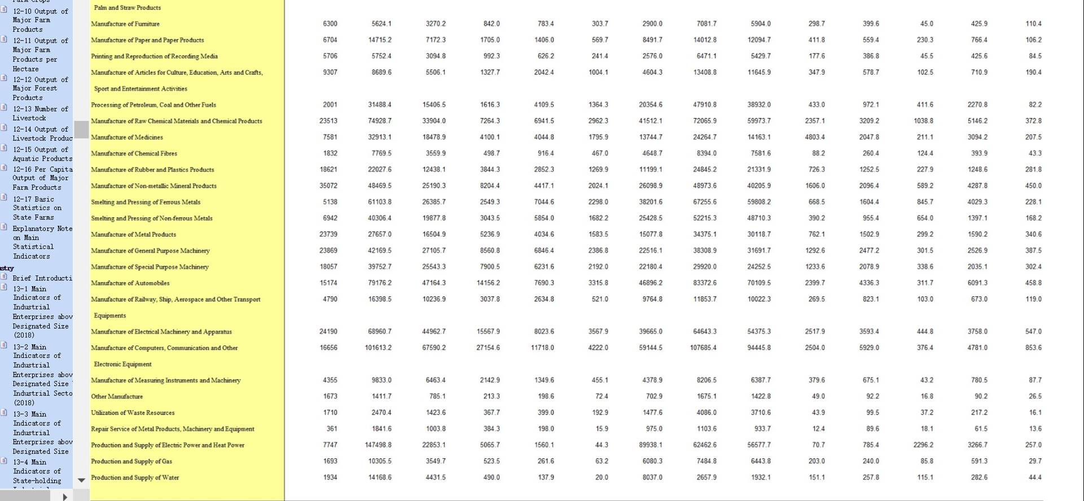
Identify Industry & obtain Financial and Manufacturing Information Related to Industry.
Step 2
Identify relevant Industry/Business and record the following data.
1. Annual Average Employees (10,000 persons)
2. Revenue from Principal Business
3. Cost of Principal Business
4. Total Profits
E.g. Business: Metal Manufacturing, Product: Fabricated Metal Products

Slide 5
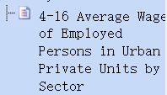
Identify Industry & obtain Financial and Manufacturing Information Related to Industry.
Step 2
Go to
Scroll down on the left menu & click on “Employment & Wages”. Next click on “4-16 Average Wage of Employed Persons in Urban Private Units by Sector” for data on wages.
http://www.stats.gov.cn/tjsj/ndsj/2019/indexeh.htm

Slide 6
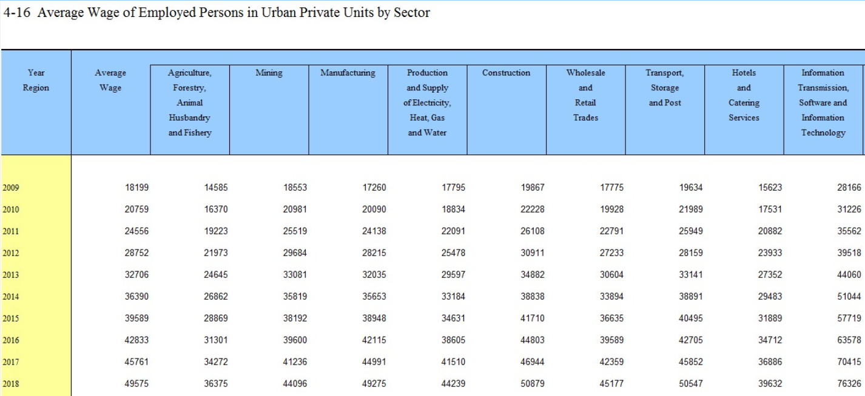
Identify Industry & obtain Financial and Manufacturing Information Related to Industry.
Step 2
Identify relevant Industry/Business and record the following data.
1. Average Wage of Employed Person for the year of interest.
E.g. Business: Metal Manufacturing, Product: Fabricated Metal Products

Slide 7
Use Financial and Manufacturing Information to Calculate Ratios
Step 3
1.. Calculate the Direct Labor (DL) ratio as percentage of Sales
DL=(Average Annual Employed Persons * 10,000 * Average Wage/100,000,000)
 | Average Annual Employed Persons | 340.6
 | Average Wage | 49275
 | Direct Labor (Average Annual Employed Persons * 10,000 * Average Wage/100,000,000) | =(340.6*10,000 * 49275/100,000,000)
 | Direct Labor (DL) | 1678
 | Revenue from Principle Business | 34375
 | Direct Labor (DL) | 4.88%
1.

Slide 8
Use Financial and Manufacturing Information to Calculate Ratios
Step 3
Steps: 3 - 4
3. Calculate Cost Of Goods Sold (COGS) as percentage of Sales
4. Apply Korean data as proxy for the following ratio to determine Direct Material (DM):
Direct Material/Cost of Goods Sold: 55%
DM =COGS * 55%
 | Cost of Principal Business | 30,119
 | Revenue from Principal Business | 34,375
 | Cost Of Goods Sold (COGS) | 87.6%
 | Cost Of Goods Sold (COGS) | 88%
 | DM/COGS | 55.0%
 | Direct Material (DM) | =0.55*88%
 | DM | 48.5%
2.
4.
Notes:
Korea-
Basic Metal Manufacturing
COGS 116,108,609
DM 79,607,506
DM/COGS=68%

Slide 9
Use Financial and Manufacturing Information to Calculate Ratios
Step 3
Steps: 5 - 6
5. Calculate Manufacturing Overhead (MOH)
6. Calculate Profit before Tax (PBT) as a percentage of Sales
7. Calculate GSA & Other Expenses as follows:
5.
 | MOH = COGS-DL-DM | =88-4.9-48.5
 | MOH | 34.2%
 | Total Profits | 1,590
 | Revenue from Principal Business | 34,375
 | PBT | 4.6%
 | Total | 100.0%
 | less COGS | 88%
 | less PBT | 4.6%
 | GSA & Other Expenses | 7.8%
MOH = COGS-DL-DM
6.
7.
GSA & Other = 100-COGS-PBT

Slide 10
Present all your calculated ratios in the cost breakdown format
Industry cost profile for “Fabricated Metal Product”
 | Direct Material (DM) | 48.5%
 | Direct Labor (DL) | 4.9%
 | Manufacturing Overhead (MOH) | 34.2%
 | Cost of Goods Sold (COGS) | 87.6%
 | GSA & Other Expenses | 7.8%
 | Profit Before Tax (PBT) | 4.6%
 | Total Sales | 100.0%
Ratios calculated from ”Economic Statistics System”

